Slide 1
Developing a Data Mining Framework to Identify a Sense of Gentrification through Social Media Data:
A Case Study Using Instagram Posts in Salt Lake City, Utah
Cheng-Chia (Karie) Huang
Committee Members:
Dr. Atsushi Nara (Chair)
Dr. Ming-Hsiang Tsou
Dr. Joseph Gibbons

Slide 2
Layout
Background
Research Questions
Study Area and Research Design
Data and Methods
Results
Conclusion

Slide 3
Background
The term, “Gentrification,” was coined by a British sociologist Ruth Glass in 1964.
Gentrification is a transformation of a working-class or vacant area of a city under the influence of redevelopment and influx of higher-income residents, which involves economic upgrading and replacement of long-term residents who were often of lower social status.
(1) Sharp increase in house value and rent.
(2) Displacement; residential displacement and cultural displacement.

Slide 4
Research Gaps
1. Take the advantage of both quantitative strategies & qualitative approaches.
2. Incorporate human perception of neighborhoods to a large region.
3. Examine Gentrification dynamics in a large area at finer spatial-temporal scale.

Slide 5
An Opportunity Social Media Brings
Social media has both “big” and “deep” characteristics (Sui and Goodchild, 2011)
We can follow opinions, ideas, and feelings of hundreds of millions of people through social media (Manovich 2011).

Slide 6
Layout
Background
Research Questions
Study Area and Research Design
Data and Methods
Results
Conclusion

Slide 7
Research Questions
How applicable are existing measurements to identify gentrifying areas?
Review existing census-based typology methods.
Replicate five gentrification typology distributions based on these census-based methods.
Compare five gentrification typology distributions with human-perceived gentrifying areas which are the areas people regarded as gentrifying
(2) Can social media data approach incorporating human perception better identify gentrifying areas as compared to conventional census-based typologies?
Introduce a social media based framework which uses two gentrification indicators—nightlife activities and gentrification ambience—to capture a sense of gentrification.
Compare the sense of gentrification identified by this social media approach with human-perceived gentrifying areas.
Notes:
(1) This research compared gentrifying areas identified by quantitative and qualitative measures.

Slide 8
Layout
Background
Research Questions
Study Area and Research Design
Data and Methods
Results
Conclusion

Slide 9
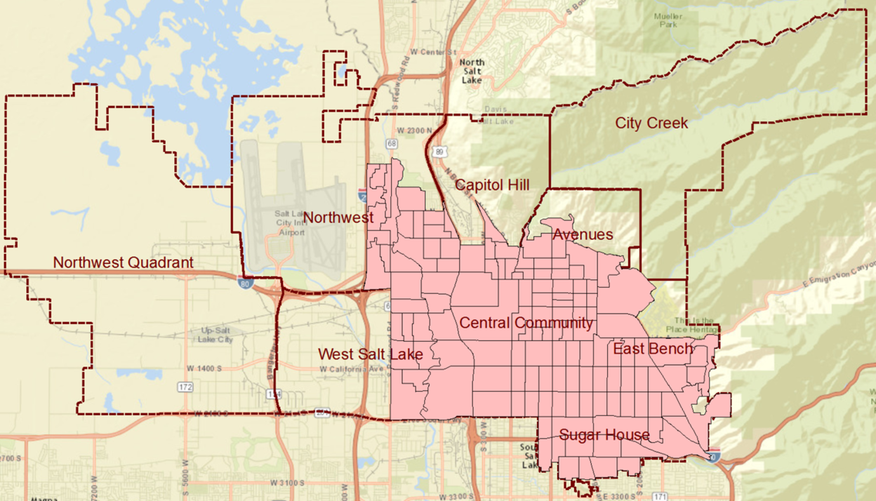
Study Area: Salt Lake City
Notes:
Why Salt Lake City? (1) According to the report on U.S. Census website, Utah is the fastest-growing state. The growth of population is associated with its urban development, and it might result in significant gentrification phenomenon in its city areas. (2) Comparing to other cities, Salt Lake City is more compact, and it developed in Salt Lake Valley, so there are fewer factors will influence its urban development (3) I found that there are some gentrifying areas in this city.
The study area only included those census block groups which have more than 50% area within the city’s boundary. Additionally, those census block groups with the population densisty less than 5 percentile (446.02people/km2) are not discussed in this research.

Slide 10
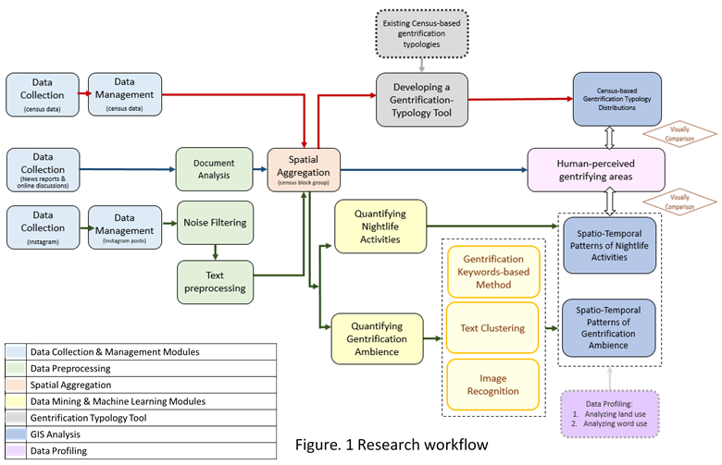

Slide 11
Layout
Background
Research Questions
Study Area and Research Design
Data and Methods
Results
Conclusion

Slide 12







The Main Software and Tools

Slide 13
Data Collection
Category | Source | Data Collection
Census Data | 1. 2000 decennial data (154 fields) 2. 2014 ACS 5-year estimate data (73 fields) | 1. Census FactorFinder 2. Census FTP server
News reports and discussions on online forums | 1. The Great American 2. Country 3. Salt Lake Tribune 4. Summit Sotheby's 5. International Realty 6. Utah Stories 7. Reddit 8. Zillow | Search Keywords: gentrification and Salt Lake City Duration: 2000-2015
Social Media Data | Instagram | Instagram API Duration: 2013/1/1~2015/12/31
2015 Parcel Data | SanGIS | 2015 – 1st Quarter

Slide 14
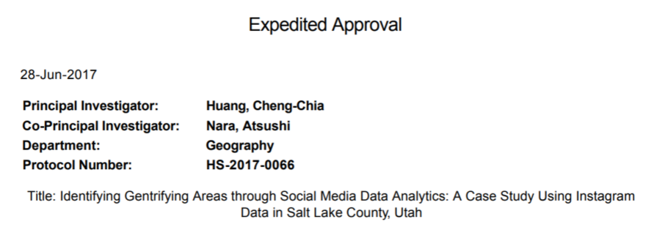
IRB Examption

Slide 15
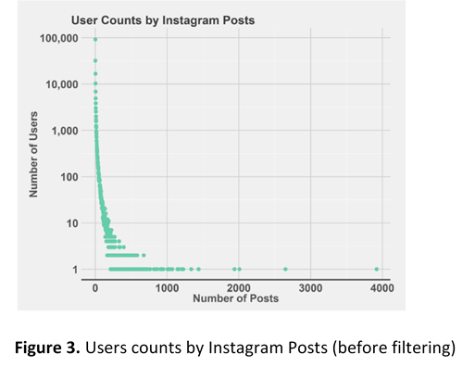
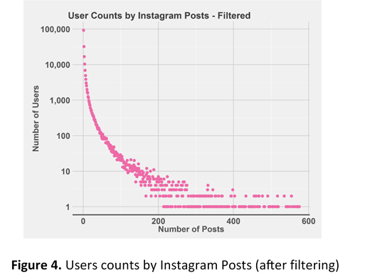
Filter extreme users: remove users with post counts above the 90th percentile of posting frequencies during 2013-2015.
Dates | Total Counts in Entire County (before filtering) | Total Counts in Entire County (after filtering) | Total Counts in Study Area
2013/1/1 ~ 2015/12/31 | 1,236,070 | 1,120,823 | 652,190
Notes:
County and city
1236070

Slide 16
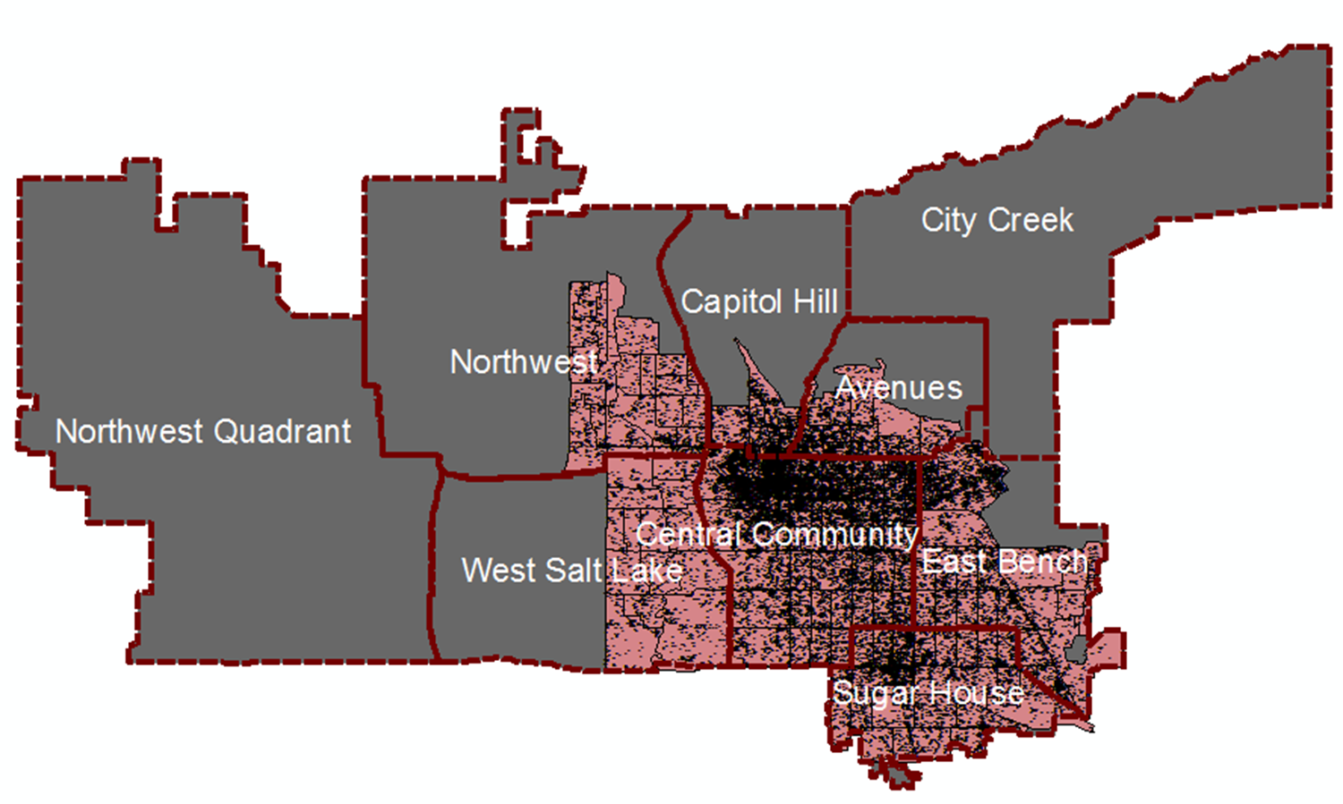
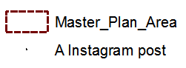
An Instagram Post

Slide 17
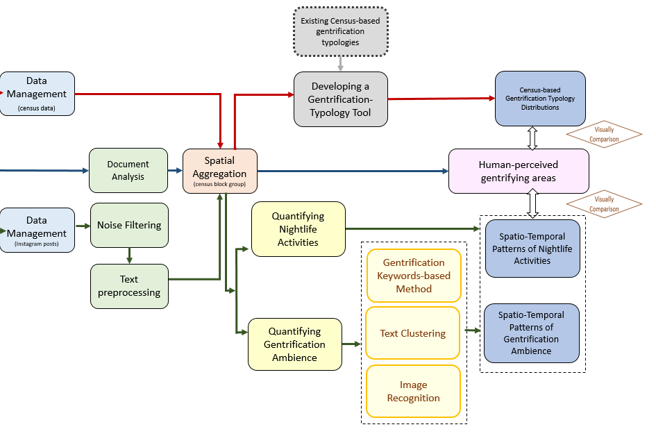
Notes:
The major part of this research is a social-media based framework which helps us identify a sense of gentrification by capturing the cultural characteristics of gentrification.
To measure the cultural characters, I construct two gentrification indicators. One is nightlife activities and the other is gentrification ambience.
To measure the cultural characteristics of gentrification, this research uses two indicators. One is nightlife activities and the other is gentrification ambience.

Slide 19
Gentrification keywords:
night, tonight, gentrification, gentrifier(s), gentrifying, gentrified, bar(s), coffee, café, restaurant(s), gallery/galleries, young, youth, trendy, aesthetic(s), art, hipster(s), beer, gay(s), lesbian(s), Victorian, bohemian, yoga, yuppie, expensive, and pricey
tonight | night | gentrif | gentri | bar | coffe | cafe | restaur | galleri | young | youth
trendi | aesthet | art | hipster | beer | gay | lesbian | victorian | bohemian | yoga | expens
Notes:
Domain experts: Michael, Joe, Kate…
However, Instagram restricts people to analyze the photos with computational technique. it says

Slide 21
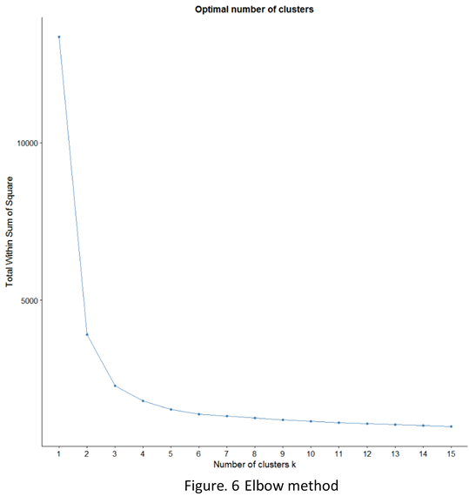
Text Clustering Method:
Clustering census block groups with their Instagram captions’ similarity:
A. To combine all Instagram text in a census block group.
B. text pre-processing: removing punctuations, stop words, emoji,
and stemming.
C. TF-IDF (Term Frequency–Inverse Document Frequency)
D. Normalize TF-IDF with number of unique users in each census block group
E. Elbow Method and try and error: 7 clusters
F. Text clustering with cosine distance

Slide 22
Layout
Background
Research Questions
Study Area and Research Design
Data and Methods
Results
Conclusion, Challenge and Future Works

Slide 24
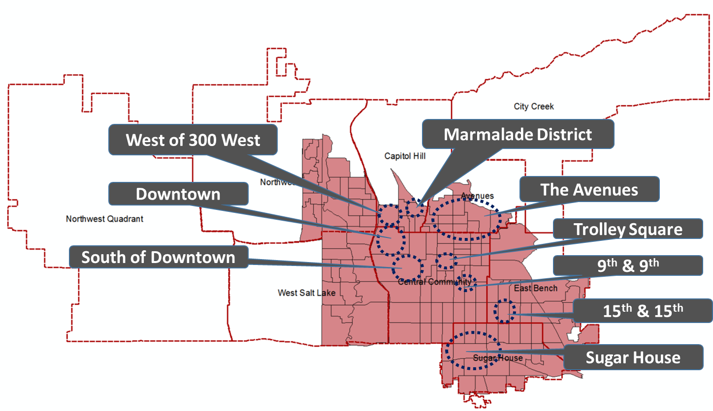
Human-Perceived Gentrifying Areas
With Google Search Engine, those materials were selected when they contained two keywords, “gentrification” and “Salt Lake City,” and were posted during 2000-2015.
11 news reports and discussions on online forums were collected.
Sources are from:
Great American Country
The Salt Lake Tribune
Utah Stories
Summit Sotheby's International Realty
Zillow
Reddit
Figure. 7 Human-perceived gentrifying areas in Salt Lake City

Slide 26
Census-based Gentrification Typology
Bostic and Martin’s method, (2) Freeman’s method, (3) Ding, Hwang and Divringi’s method, (4) McKinnish, Walsh, and White’s method, and (5) Voorhees Center’s method
Compare two time points
The change of income is the major criterion; some methods also consider demographic characters.
Notes:
Need to compare two time point to see if some characteristics change in a particular way

Slide 27
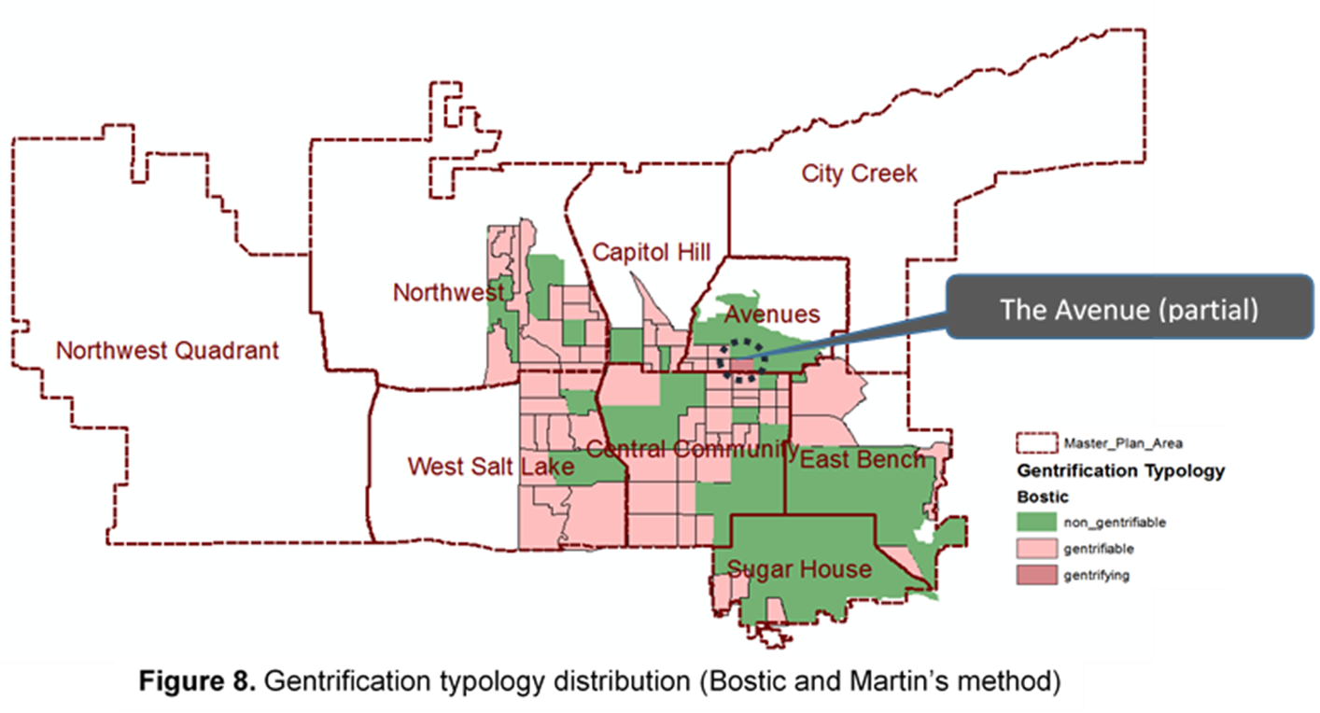
Census-Based Gentrification Typology 1
Bostic and Martin’s Method
Notes:
1. it only selects one area with highest average rank in 9 gentrifiable factors as a gentrifying place.

Slide 28
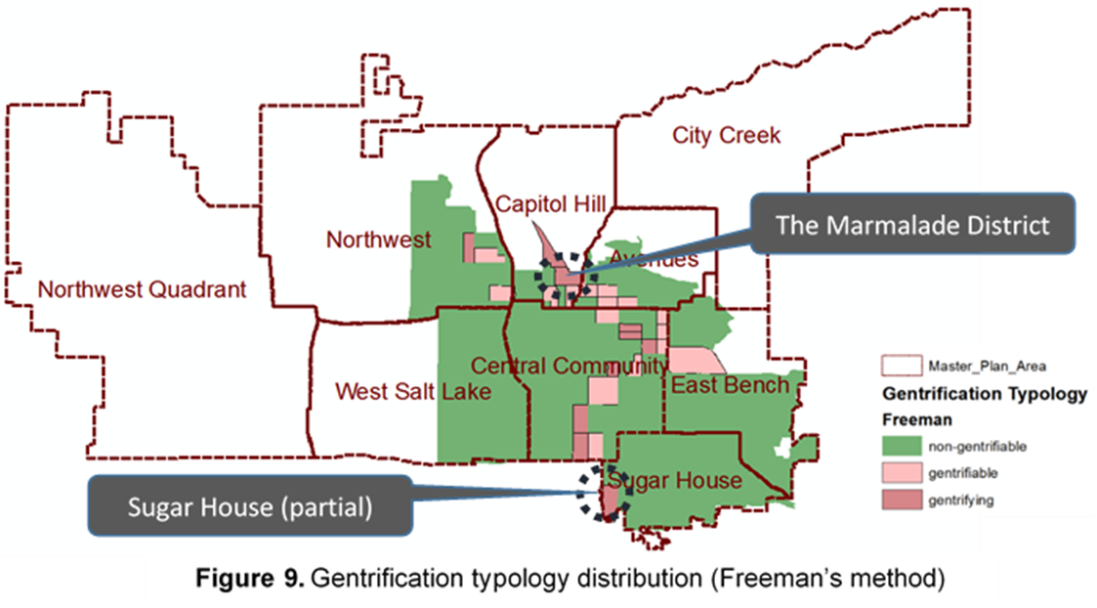
Census-Based Gentrification Typology 2
Freeman’s Method
Notes:
Rigorious definition of gentriable area. The more regorious defition of a gentrifiable area, the less gentrifying area it would identifies. (1) the median income of the area in the prior year must be lower than the median of the city (2) the propotion of new building in the area within past 20 years lower than the median proportion of the entire city. Eg. Although The educated residents and the rent increase significantly in Downtown, there are too many new building in the prior time point.

Slide 29
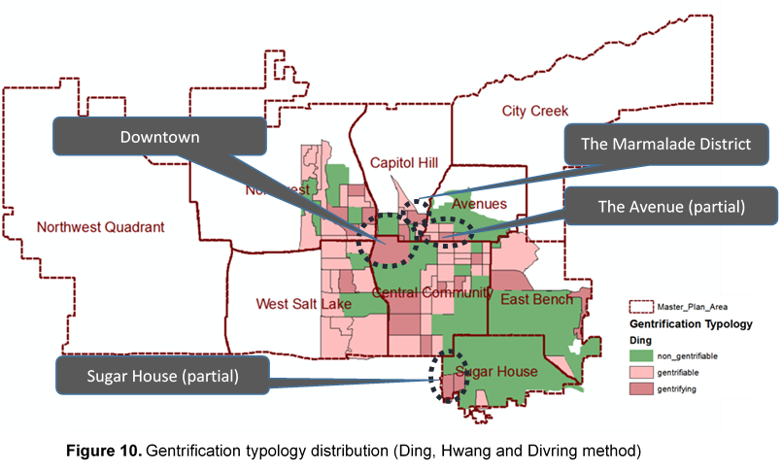
Census-Based Gentrification Typology 3
Ding, Hwang and Divring’s Method

Slide 30
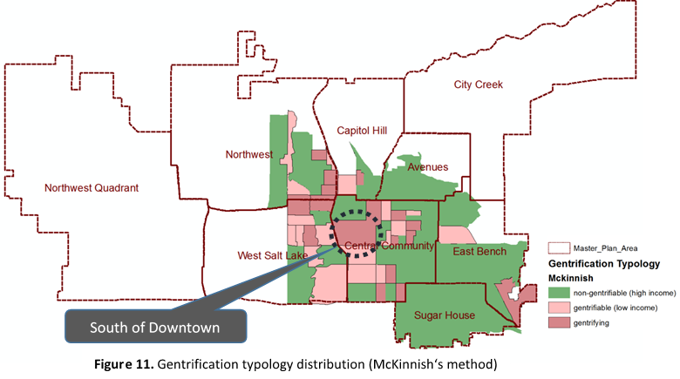
Census-Based Gentrification Typology 4
McKinnish’s Method
Notes:
The major reason is its strict definition of a gentrifiable area. A gentrifying area must have average family income which is at the bottom quantile of the entire city at the beginning of a period of time. If a place has high median income at prior year, no matter how much its median income increase after a period of time, it will not be recognized as gentrifying.
this method only relies on economic change and doesn’t take demographic factors into account. Therefore, if the income chage doesn’t meet a certain number, no matter how many college-educated people or white collor people increase in a census block group, the block group would not be identified as gentrifying.

Slide 31
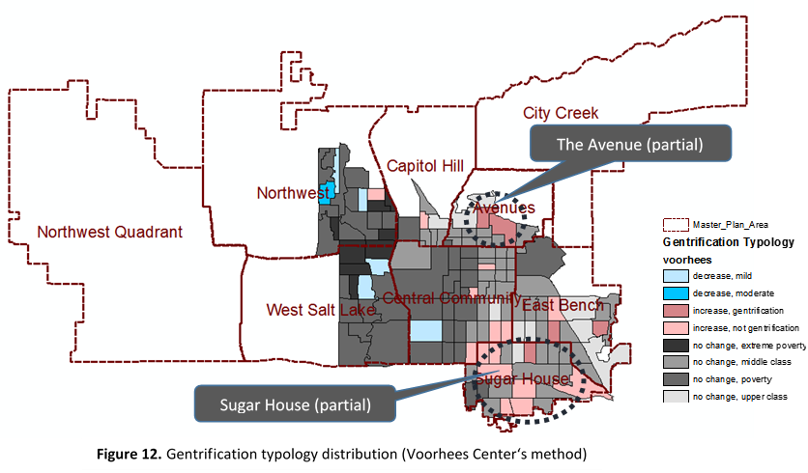
Census-Based Gentrification Typology 5
Voorhees Center’s Method
Notes:
Although Voorhees center’s method only identified two human-perceived gentrifying areas, most socioeconomic increase areas it identified are located in human-perceived gentrifying areas.

Slide 32
The limitations of these census-based methods
They identified different areas as gentrifying.
While Ding’s method and Voorhees center’s method better capture human-perceived gentrifying areas, they do not match human-perceived gentrifying areas very well.
All these methods do not include the cultural measurement to detect the cultural characteristics of gentrification.
Notes:
Reason 3, to measure cultural characteristics, we need to use other cultural mesurement like the number of coffee shops (but it only mesure a certain consuming pattern); or we need to incorporate human perception like conducting fieldwork or interviewing the local people (but it is time comsuming and labor intensive)
Therefore, this research introduces a social media based approach which help us to detect the cultural characteristics of gentrification.

Slide 34
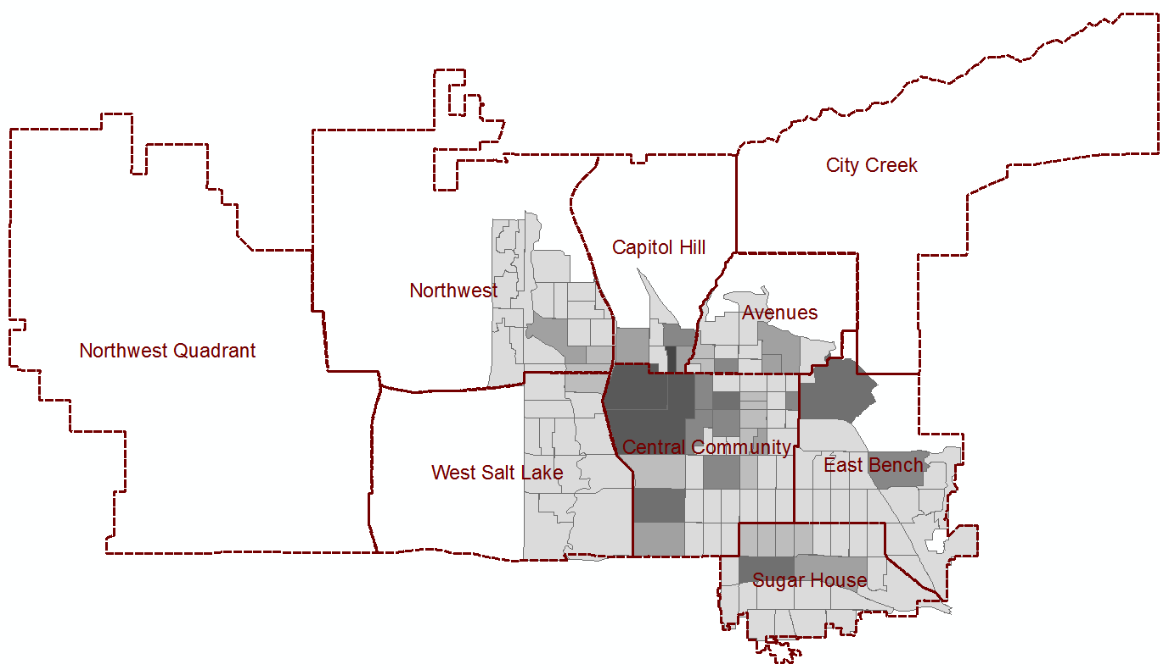
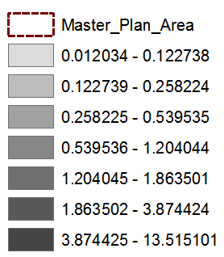
The Pattern of Instagram Night Posts in 2013
(490351006003)
University of Utah
Hogle Zoo /Bonneville Golf Course
Liberty Park
(490351029002)
Figure 13. Patterns of Instagram Night Posting in 2013

Slide 35

The Pattern of Instagram Night Posts in 2014
Figure 14. Patterns of Instagram Night Posting in 2014

Slide 36
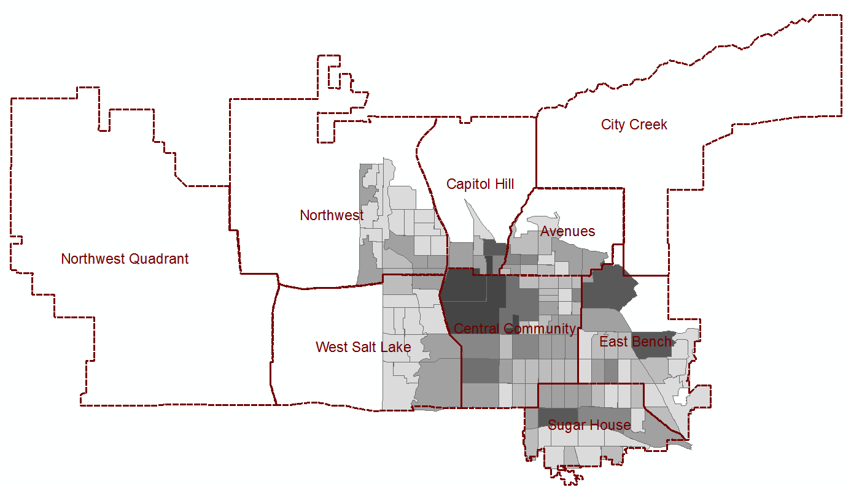
The Pattern of Instagram Night Posts in 2015
Figure 15. Patterns of Instagram Night Posting in 2015

Slide 38
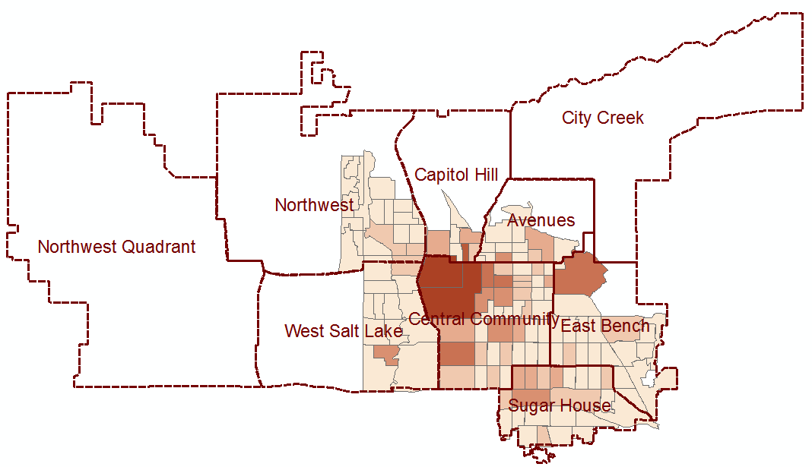
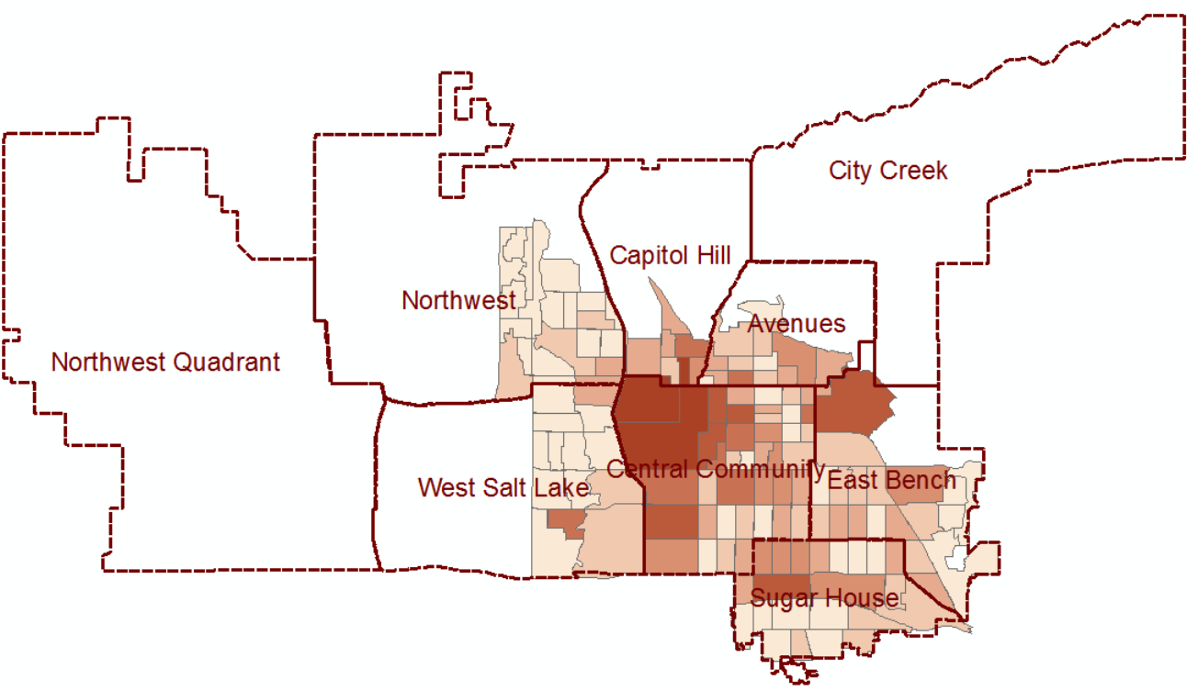
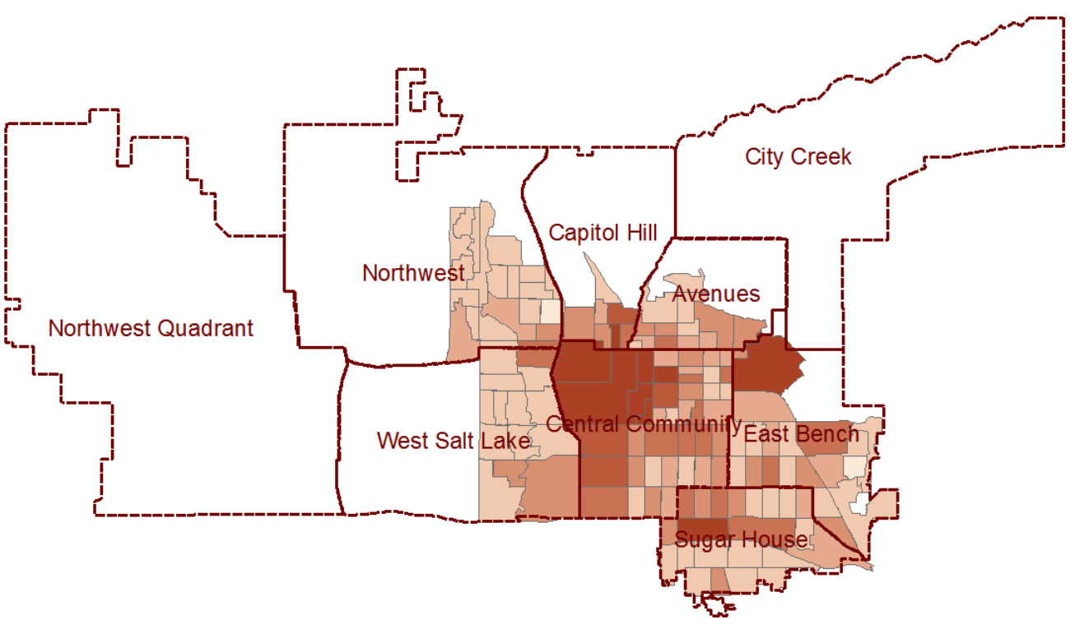
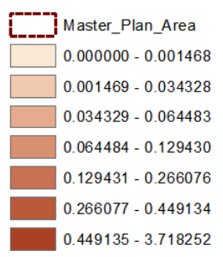
The Patterns of Gentrification Keywords
2013
2014
2015

Slide 39
Notes:
Use clustering not classification because we don’t know the actural gentrifying areas

Slide 40
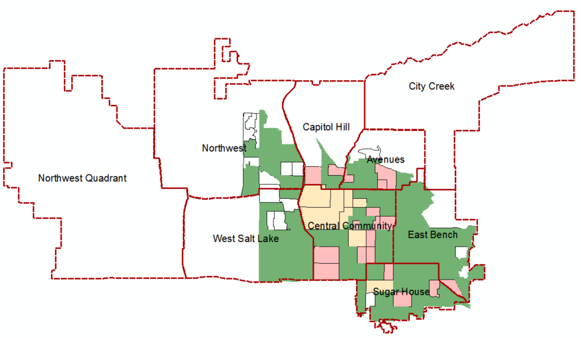
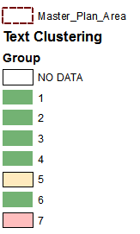

2013
Marmalade District
West of 300 West
The Avenues
Downtown
South of Downtown
9th & 9th
Trolley Square
Sugar House
15th & 15th

Slide 41
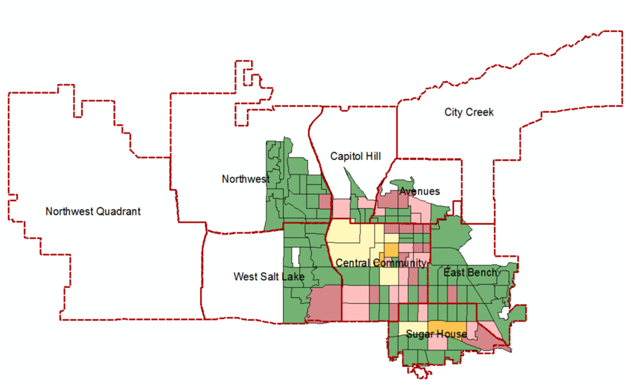
2014

Slide 42
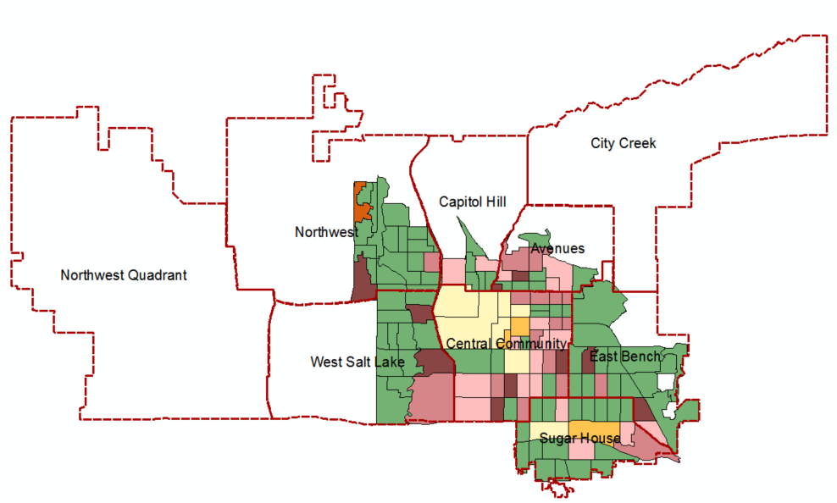
2015

Slide 43
Commercial Gentrification
(Lees, Slater, and Wyly’s, 2008)
Residential Gentrification
(Lees, Slater, and Wyly’s, 2008)
Downtown, Sugar House, Trolley Square
Most gentrifying areas
Notes:
Master plan:

Slide 44
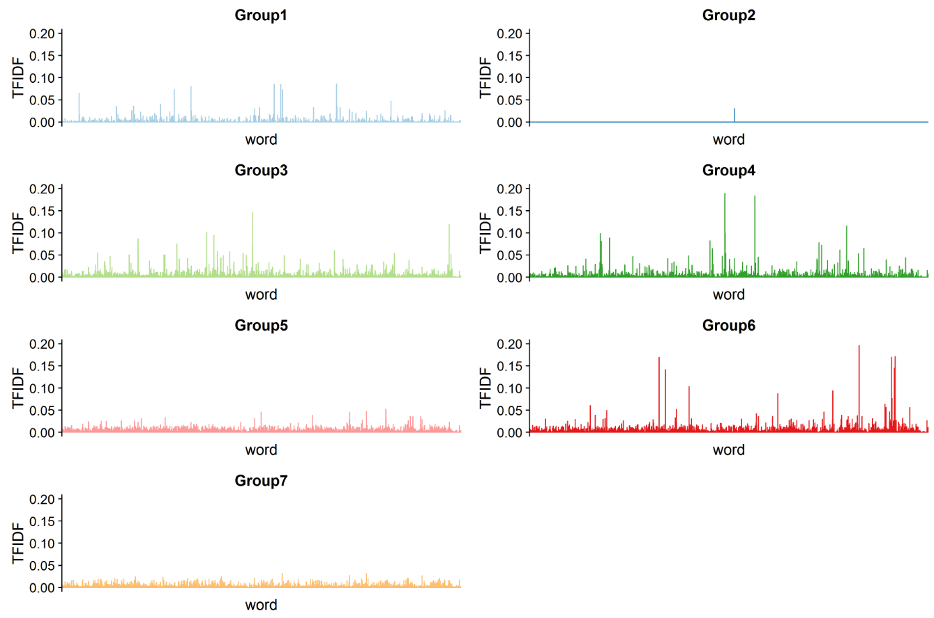
(The gentrifying group)
Diverse word use
(The gentrifying group)
Diverse word use
* The TF-IDF is normalized by the number of unique users in each census block group.
Figure 28. The Average of TF-IDF of Each Word in different Groups
the place which experiences gentrification has most diverse venues and visitors there (Hristova et al. , 2016)
Notes:
I also looked into the use of words. I want to know if gentrifying areas have different word use.
However, does this result mean that gentrification keywords play no role in gentrifying areas?

Slide 45
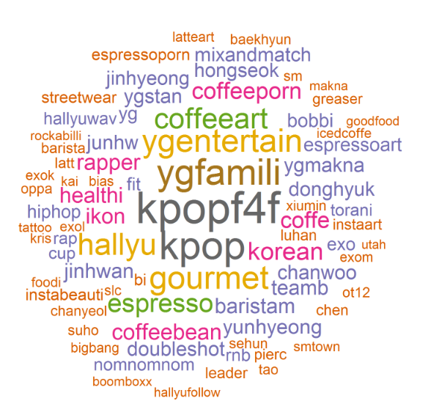
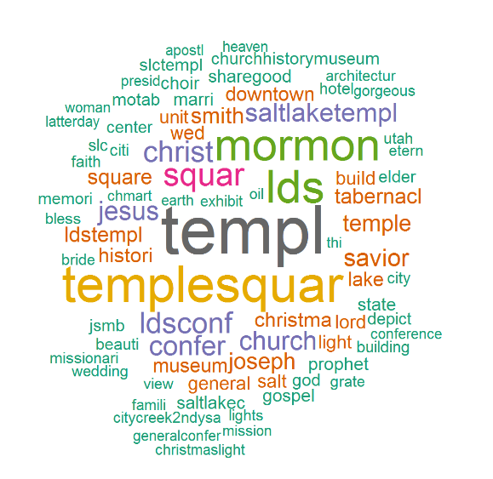
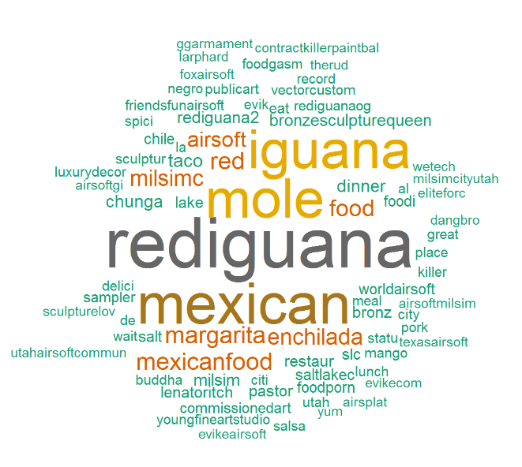

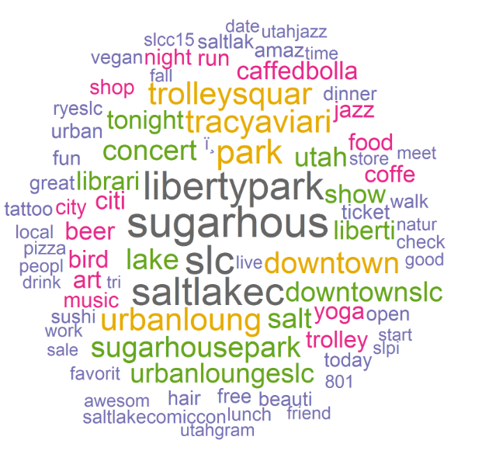
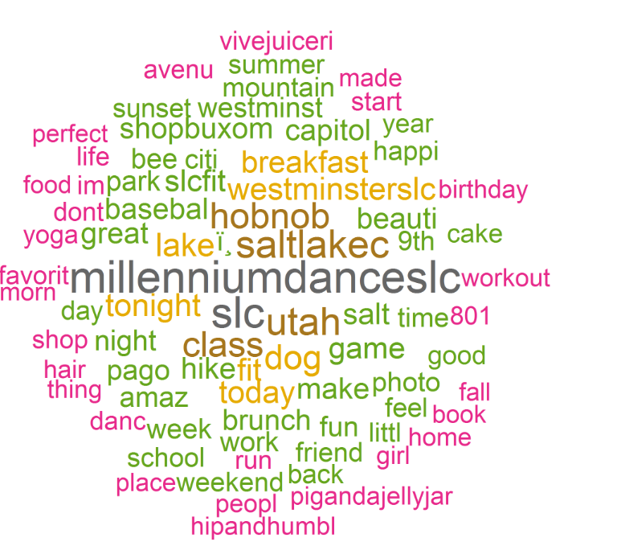
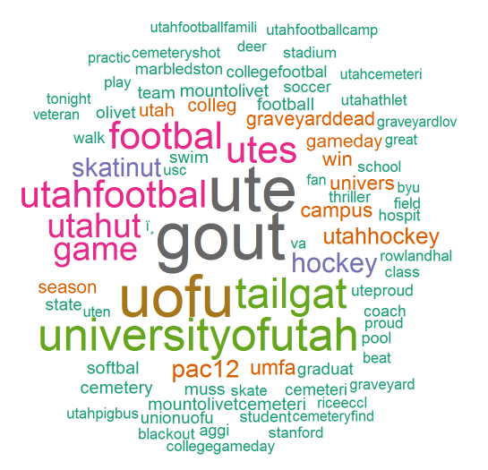
Group 1 (The top 100 Average of TF-IDF)
Group 2 (The top 100 Average of TF-IDF)
Group 3 (The top 100 Average of TF-IDF)
Group 4 (The top 100 Average of TF-IDF)
Figure 35. Group 7 (The top 100 Average of TF-IDF)
Group 5 (The top 100 Average of TF-IDF)
Group 6 (The top 100 Average of TF-IDF)
The gentrifying group
The gentrifying group

Slide 47
Layout
Background
Research Questions
Study Area and Research Design
Data and Methods
Results
Conclusion, Challenge and Future Works

Slide 48
Conclusions
The social media based data framework helped us identify human perceived gentrifying places where were not recognized with conventional census-based strategies.
This social media based strategy identified different types of gentrification.
Social media data analysis helped us to explore gentrification dynamics at a finer spatial-temporal scale.
The sense of gentrification was expanding along the gentrifying areas over years.
The poor neighborhoods near a place which experiences gentrification are likely to upgrade
(Guerrieri, Hartley, and Hurst, 2013; Hackworth 2007).

Slide 49
Challenges and Future Works
The lack of the exact boundaries of human-perceived gentrifying areas, and a yearly gentrification typology distribution for statistically validating the Instagram posting patterns.
The uncertainty of geo-tag information
Using Instagram posts at night time is too simple to represent nightlife activities.
Some gentrification keywords might play less important roles than other keywords. Such as “night” and “coffee.”
The shifting of Instagram user behavior might affluence the text clustering results.
Normalization
Mix three approaches or even mix with census-based methods
Notes:
Bivariate morian I cannot be applied to categorical variables

Slide 50
Thank you for your participation and questions

